Slide 1
Academic mobility at GSI
Information for MScGH students
Departures :
Autumn semester 2024
or
Spring semester 2025
Academic Mobility Service

Slide 2
Why go on mobility?
Experience a different culture
Taking courses not offered at GSI
Expanding your network
Enrich your CV.
Deepening a foreign language
Academic Mobility Service

Slide 3
What does it mean to go mobile?
Obligation to study abroad -> establish a study plan and follow it
Taking exams abroad
Validate ECTS credits at GSI = Mobility module
Academic Mobility Service

Slide 4
The different types of agreements
World destinations (Collaboration Agreement)
European disciplinary destinations (ERASMUS Programme)
European multi-faculty destinations (ERASMUS / Multi-faculty Programme)
Swiss mobility
Dual Masters degree with the Graduate Institute
Academic Mobility Service
Notes:
World agreements: multi-faculty => competition (grades are important, and English language skills)
SEMP (ex Erasmus): agreements by discipline
Everything in the world must come first (Europe).
Europe is selected in February and March, World is selected before Christmas.
If you choose to register for a world destination(s) :
Excellent record (academic average >5), possibility of putting 3 destinations WORLDWIDE
Good record (>4.5), possibility of putting 2 WORLD destinations
Below 4.5, it is maximum 1 WORLD destination

Slide 5
GSI Guidelines
"Application Guideline on Mobility for a Masters' Stay".
Available soon on the GSI website: https://www.unige.ch/gsi/fr/espace-etudiants/espace-etudiants-mobilite/mobilite-masters/
Obligation to read it and return the last page to the contact person at GSI at the time of final validation of the mobility study plan
Notes:
Show the guidelines on mobility all details of this presentation are given in the guidelines

Slide 6
Regulatory reminders
A maximum of one semester
Free mover not authorised obligation to leave within the framework of an agreement signed between the University of Geneva and the partner universities
Departure in 3rd semester (autumn 2024) or 4th semester (spring 2025)
All ECTS will be counted in the «focus area» semester block.
A maximum of 30 ECTS can be counted in the block, please notify your academic advisor if you are taking «extra-cursus» courses.
30 ECTS at the Graduate Institute if you want to be eligible to the dual degree

Slide 7
Destinations
Student's choice
Study topics proposed by the host university
Interesting geographical location, but of lesser importance
Moving away from popular geographical destinations
Do not neglect the interest of Swiss mobility
Remain open to less popular but potentially more rewarding destinations

Slide 8
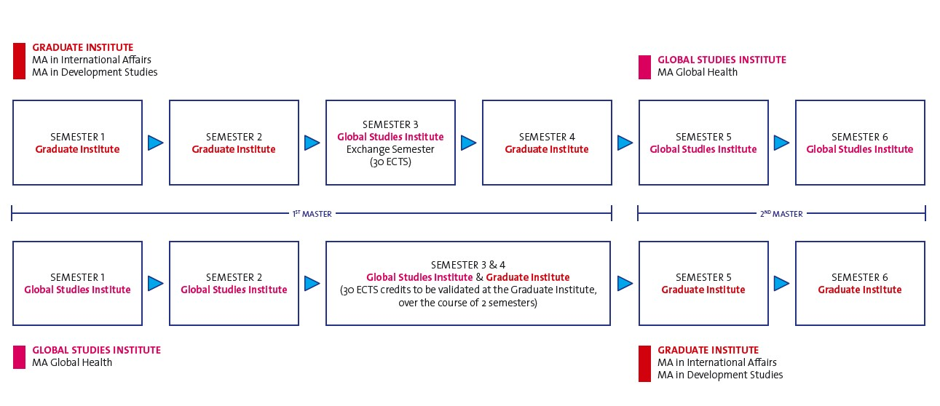
Dual Masters with the Graduate

Slide 9
Dual Masters with the Graduate
If more than 10 candidates Masters of science in Global Health coordination team determines eligible candidates.
30 ECTS to be done with the Graduate Institute to be eligible.
Candidacy to other program submitted during exchange semester.
Admissions not automatic (each institution chooses admitted candidates to their own program)

Slide 10
Study plans
Course level: you are in MA, so you must choose MA level courses
Teaching in more than one department/faculty: responsibility of the student to check with the host university
Course/seminar correspondence: not important, it is the content that is essential.

Slide 11
Conversion of credits
Credit system differs between universities
Europe: ECTS in general
Other countries: each university may have its own credit system
Conversion to ECTS is often available
Otherwise evaluation of the hourly volume (1 ECTS = 25-30 hours of work)
Some examples outside ECTS:
Australia: 1 credit = 1.25 ECTS, or 6 credits = 7.5 ECTS
USA and Canada: 1 credit = 2 ECTS (attention UC: 1 credit = 1.66 ECTS)
Asia: 1 credit = 2 ECTS (except Malaysia 1.3 ECTS and Singapore 1.5 ECTS)
United Kingdom: 2 credits = 1 ECTS
Israel: 1 credit = 1.5 ECTS
Lebanon: 1 credit = 1.5 ECTS
American University = 1 credit = 2 ECTS

Slide 12
Dates of stay
Dates of stay defined by the academic calendar of the host university of the planned semester of mobility
Each university has its own academic calendar
Caution: potential repercussions during exam periods:
Mobility is a valid reason to obtain an excuse for an exam: send a request to the Director of GSI with proof that the mobility stay starts during the exams (email/calendar) of the host university)

Slide 13
Setting up the file
Mobility Service form including study plan
Curriculum Vitae
Cover letter (1 page A4)
Transcripts received to date (Bachelor’s or previous masters degree)
Proof of language level

Slide 14
Selection of files
Places are limited
Interfaculty agreement: selection will be made by an Interfaculty Selection Commission of the UNIGE
Faculty agreement: selection will be made by the GSI
Dual Masters mobility: Contact your academic counsellor
Conditional confirmation by the Academic Mobility Service

Slide 15
Confirmation
Conditional confirmation before publication of the results of the January/February 2024 examination session for world destinations and after publication of the results of the January/February 2024 examination session for Europe and Switzerland destinations
Conditions: minimum average of 4.00/6.0 in the core curriculum at the end of the January/February 2024 examination session
If this average is not obtained: departure not authorised, no derogation possible
Final confirmation by the host university (between summer and autumn 2024)

Slide 16
Once on site
Obligation to check at the beginning of the stay the evolution of the study plans both at the UNIGE and at the host university
Obligation to inform the Academic Advisor of any change in the study plan within 2 weeks of arrival at the host university
or risk not receiving equivalencies if not relevant to the change

Slide 17
Validation of the mobility stay
Mobility credits granted upon return from mobility
On presentation of the original transcript of records issued by the host university:
Paper format
Certified electronic format
Web link directly to the student's file at the host university
Send the transcripts to you academic advisor (it is not always automatically shared by host institutions and is your responsability)

Slide 18
In case of failure
Re-sit the failed exam(s) at the host university if this possibility is offered
Request authorization from the Director to acquire missing credits at the UNIGE the following semester if leaving in the fall or the following academic year if leaving in the spring
the duration of studies cannot be extended due to failure in mobility.

Slide 19
Latest general information
The student who leaves on a mobility programme remains registered at the UNIGE for the duration of his/her stay: student e-mail address is always valid, so it is important to consult it regularly to be kept informed. The same applies if postal mail is sent! Remember to update your address if you are leaving your accommodation in Geneva permanently due to mobility
No registration for courses taken during the mobility period is required or possible on the UNIGE portal

Slide 20
Latest general information
If you need to have your transcript translated into English, contact Mr James Tarpley, once the results of the May/June 2024 session are known. Please contact him as soon as the host university has confirmed the acceptance of your mobility place.
If offered, possibility of following UNIGE courses at a distance during the mobility (responsibility of the student)

Slide 21
Contacts
At GSI:
Bogomil Kohlbrenner (only for validation of your exchange study plan and dual masters questions)
E-mail: bogomil.kohlbrenner@unige.ch / Telephone: +41 22 379 01 86
Maud Preher (for all mobility questions that concern the GSI)
E-mail: Maud.Preher@unige.ch / Telephone: +41 22 379 37 11
Open Reception: Tuesdays from 11 am to 12pm, Wednesdays from 10 to 11:30 am, Thursdays from 10:30 to 11:30 am
Telephone answering service: Thursdays from 2:30 to 3:30 pm, Fridays from 10 to 11 am
Within the Academic Mobility Service: https://www.unige.ch/exchange/fr/contact/

